Slide 1

Myers-Briggs Personality Prediction
Sujata Gorai (hc6837 )
Nalisha Rathod (GS9440)

Slide 2
Agenda
Introduction
Related Works
Dataset
Methodology
Experiments and Results
Conclusion

Slide 3

About the Data set
The Myers Briggs Type Indicator (or MBTI for short) is a personality type system that divides everyone into 16 distinct personality types across 4 axis:
Introversion (I) — Extroversion (E)
Intuition (N) — Sensing (S)
Thinking (T) — Feeling (F)
Judging (J) — Perceiving (P)
The purpose of this project is to investigate if any patterns can be detected in a person’s specific personality type in connection to their style of writing and to explore the validity of the test in analyzing, predicting, or categorizing behavior.

Slide 4

MBTI Dataset
The dataset contains 8600 observations (people), where each observation gives a person’s:
Myers-Briggs personality type (as a 4-letter code)
An excerpt containing the last 50 posts on their PersonalityCafe forum (each entry separated by “|||”)

Slide 5
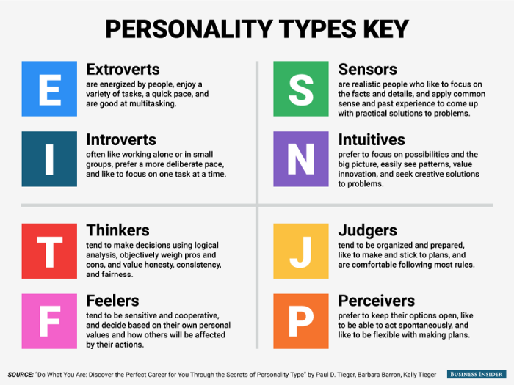
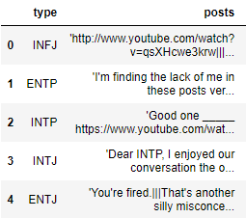
Dataset

Slide 6
Data Preprocessing
Several methods to preprocess the comments before passing to the training model.
Replaced "|||" from text with " " Join all texts written by 1 Person
Removed Links from text and replace them with 'Link'
Removed punctuation from Text

Slide 7

Deep Learning Models
We have used three deep neural network models to perform our tasks.
The models are :
1) Long Short-Term Memory (LSTM) with Dropout
2) Bidirectional Gated Recurrent Unit(GRU)
3) Pooled Gated Recurrent Unit(GRU)

Slide 8
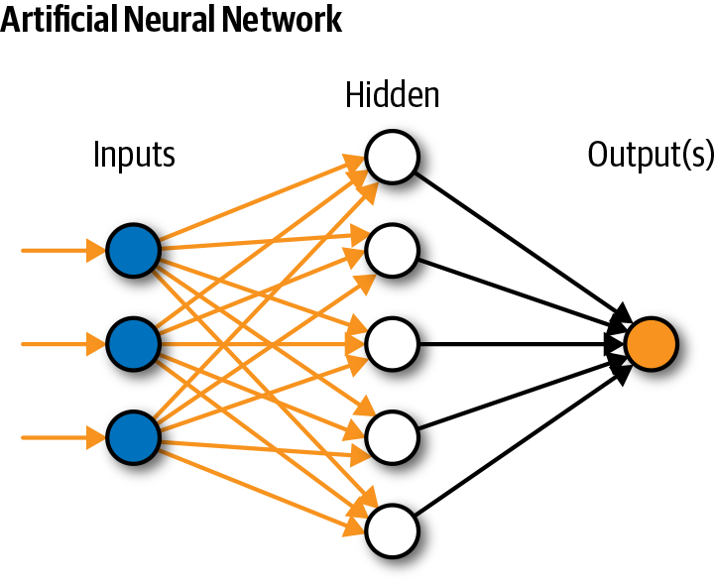
What is Deep Learning ?
Deep learning is subset of Machine Learning.
Structure inspired by human brain.
It is used in Natural Language Processing, Visual Recognition, Fraud Detection.
It describes certain types of Neural networks.

Slide 9
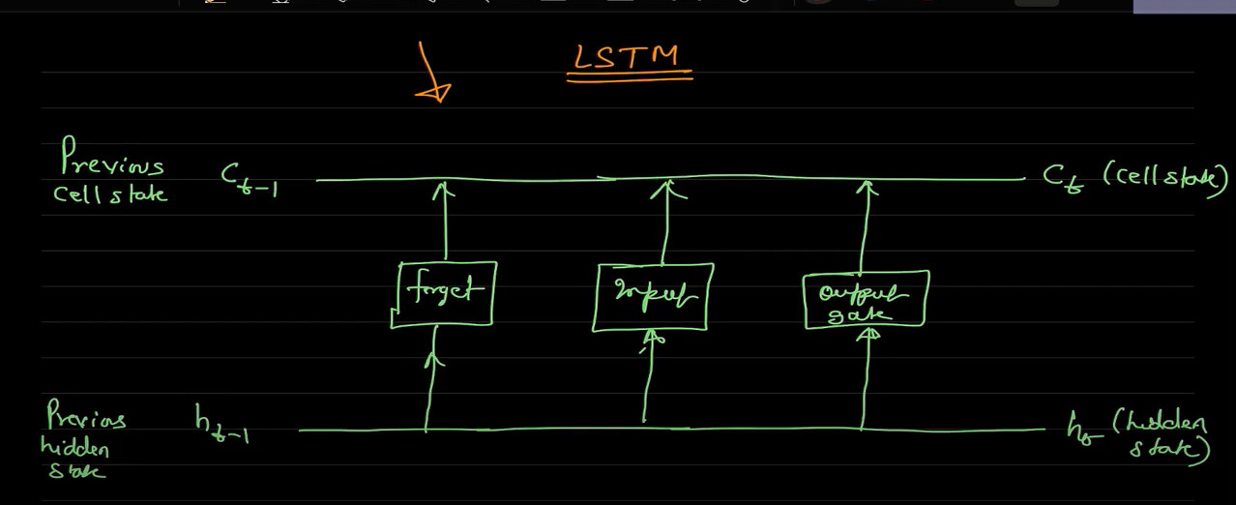
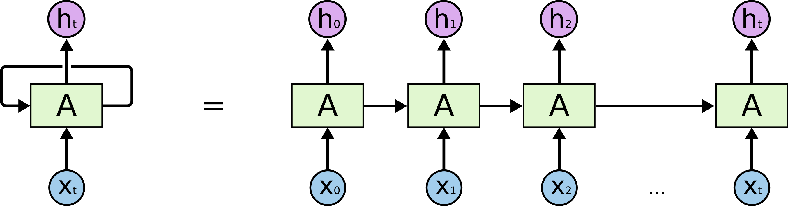
LSTM vs RNN
LSTM
RNN

Slide 10
Long Short-Term Memory (LSTM)
To reduce the problem with long term dependencies in Recurrent Neural Network (RNN).
Drawbacks of RNN
For example : 1) The sky is _______ (this can we predicted by RNN)
2) Recurrent neural networks (RNN) are the state-of-the-art algorithm for sequential data and are used by Apple’s _________(this cannot be predicted by RNN)
LSTM consists of 3 units: Input Gate, Forget Gate and Output Gate.

Slide 11
LSTM Processing
glove.840B.300d for word embedding in this model
dropout layer - reduce the overfitting problem
Parameters used are
-embed size = 50 ( how big is each word vector) -max features = 20000 (how many unique words to use) (i.e num rows in embedding vector) -maxlen = 100
Prepossessed the data with padding and tokenization
We have used loss=‘binary crossentropy’ optimizer=‘adam’ metrics=[‘accuracy’].

Slide 12
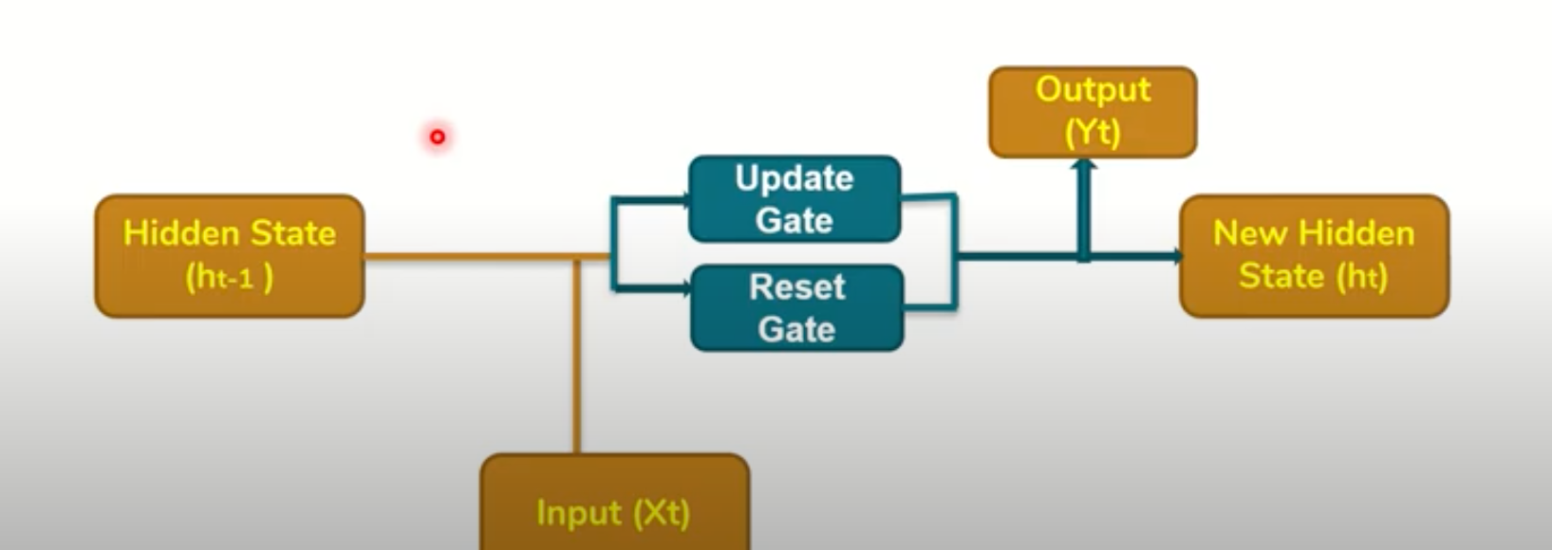
Bidirectional Gated Recurrent Unit (GRU)
GRU’s are a modifications to RNN.
It utilizes the Gate mechanism same as LTSM to manage and control the flow of information between the cells in the NN.
It has two gates Update gate and Reset Gate

Slide 13
Bidirectional GRU Processing
glove.840B.300d for word embedding in this model
dropout layer - reduce the overfitting problem
Parameters used are
max features=100000 (maximumfeatures)
maxlen=150 (maximum length) embed size=300 (size of embedding)
Prepossessed the data with padding and tokenization then convert it vector by using word embeddings.
Set two pooling layers (average pooling and max pooling) layer after bidirectional GRU layer
set dense layer
batch size = 32 and number of epochs = 2
We have used loss=‘binary crossentropy’ optimizer=‘adam’ metrics=[‘accuracy’].

Slide 14
Pooled Gated Recurrent Unit (GRU)
It is a simple GRU.
It has Pooling Layers- > Pooling Layers are used to reduce the dimensions of the feature matrix.
Therefore, it reduces the number of parameters to learn, and the amount of computation performed in the network.

Slide 15
Pooled GRU Processing
FastText 300d for word embedding in this model
dropout layer - reduce the overfitting problem
Parameters used are
max features=30000 (maximumfeatures)
maxlen=100 (maximum length) embed size=300 (size of embedding)
Prepossessed the data with padding and tokenization then convert it vector by using word embeddings.
Set two pooling layers (average pooling and max pooling) layer after bidirectional GRU layer
set dense layer
batch size = 32 and number of epochs = 2
We have used loss=‘binary crossentropy’ optimizer=‘adam’ metrics=[‘accuracy’].

Slide 16
Experiment with Deep Learning Models(is_T class- balanced)

Slide 17
is_S class- (imbalanced)

Slide 18
is_S class- (balanced)

Slide 19
Loss Calculation (is_T class)

Slide 20
Loss of is_S class (imbalanced)

Slide 21
is_S class (balanced)

Slide 22
Future Work
Apply various other classification model to this dataset and to the new domain of Data.
Trying to make the dataset balanced using different techniques.
Modify the preprocessing techniques .

Slide 23
Conclusion

